Slide 1



Ai-Maama
(Artificial Intelligence for Maternal Monitoring and Assistance in Africa)
TRACK C: HerHealth & Wellness
Presented by Team SaveHer

Slide 2

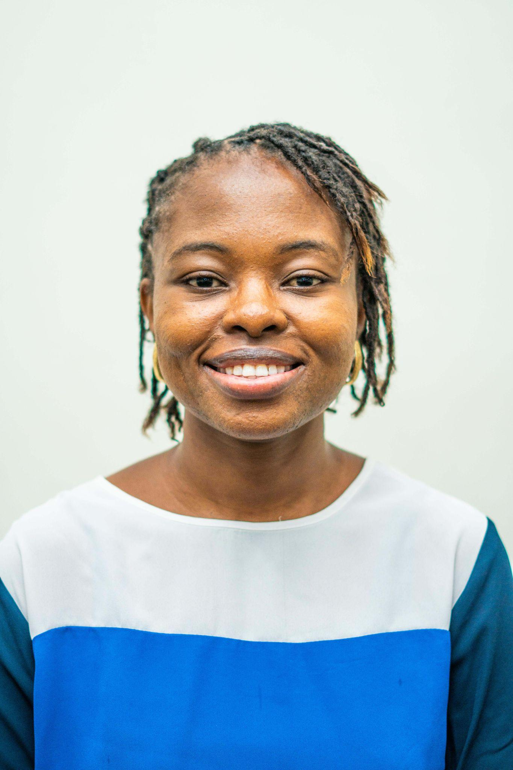
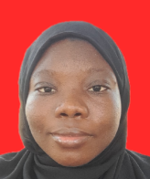
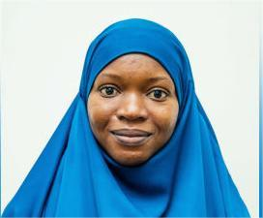
Meet Our Team
1
2
3
1
Oluwatosin Ogunsola —
Team Lead
Olorundare Abiola Aisha — Member
Abayomi Taofeeka — Member
Biochemist and AI Engineer with 2+ years ML experience.
Biomedical Engineer and AI Engineer.
Veterinarian and AI Engineer.
Notes:
2

Slide 3

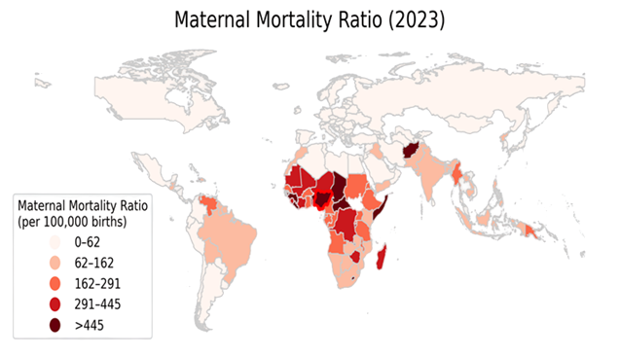
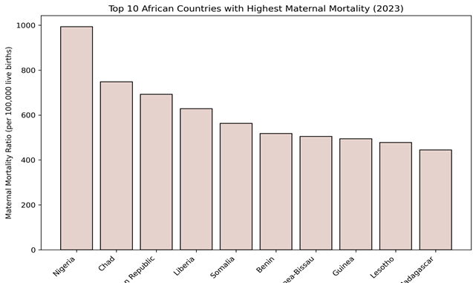
Problem Statement
Nigeria loses over 80,000 women every year to pregnancy and childbirth complications (WHO).
Postpartum Hemorrhage (Excessive bleeding after child birth) accounts for 70% of these deaths especially in the rural areas.
Healthcare workers can only act after a mother’s condition becomes critical. This delay costs lives.

Slide 4
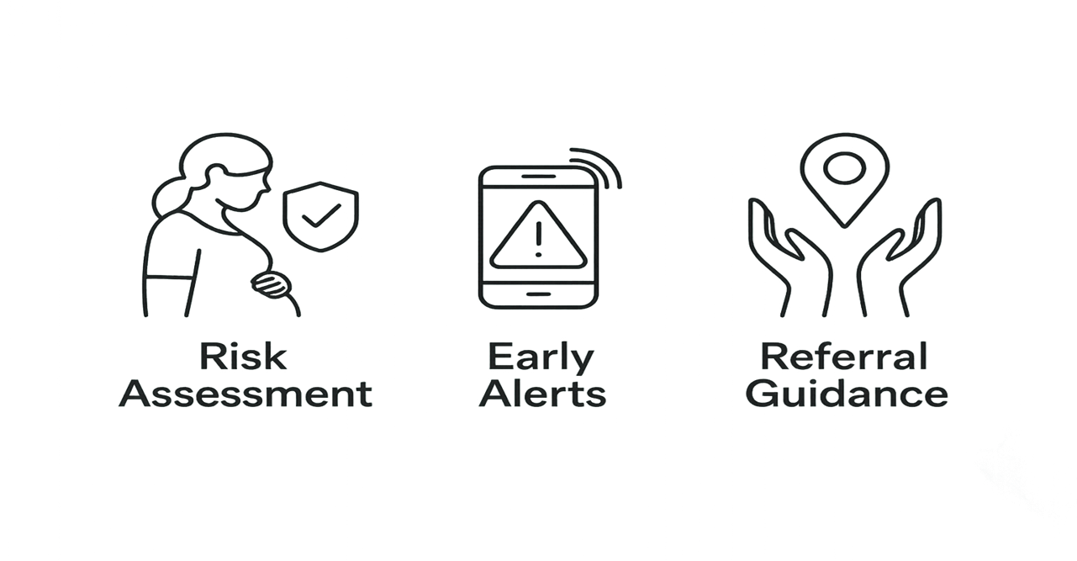
Our Solution: Ai-Maama, Your Predictive Partner
Ai-Maama is an AI-powered web application
It is designed for pregnant women and community healthcare workers.
It provides early, accurate prediction of Postpartum Hemorrhage (PPH) risks

Slide 5


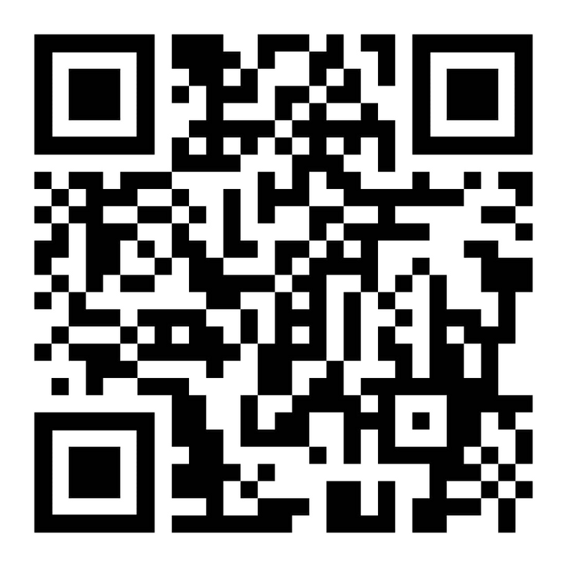



How it works
Patient data is entered (clinical + demographic details).
Ai-Maama’s predictive model calculates risk.
High-risk women are flagged for closer monitoring.
Healthcare workers receive suggested preventive actions.
Scan Me

Slide 6
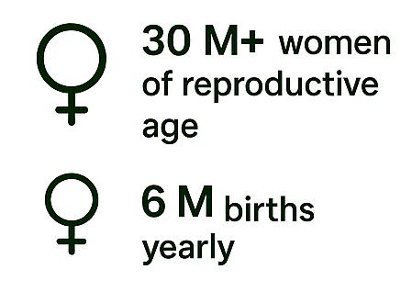
Nigeria’s Market Opportunity for AI-Maama
Notes:
2

Slide 7
Technology Stack
Frontend: [React.js]
Backend: [FastAPI]
ML: [XGBoost Classifier, Random Forest]
Deployment: [Render, Netlify]
Notes:
2

Slide 8
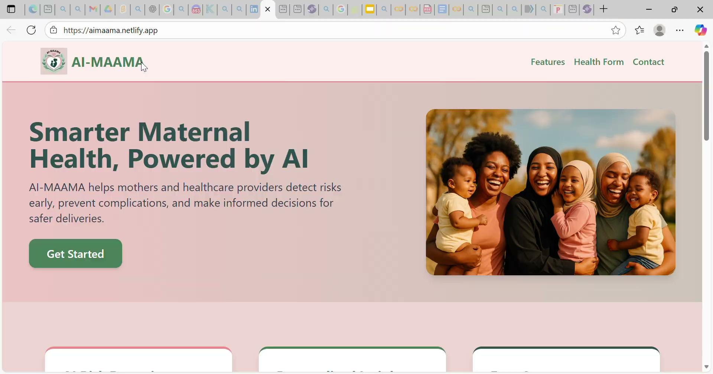

Slide 9
Development Process
Problem Statement
Data collection from Nigerian women
Creation of risk-prediction model using features from data collected and Kaggle dataset
Integration of model into a web-application
App Deployment and Testing
Notes:
2

Slide 10
Results
Outcomes: A working prototype; a web-application that predicts PPH risk with our ML model.
For each risk prediction, it displays further guidance
Metrics/KPI: Accuracy, F1 score; Achieved great accuracy and F1 Score for each risk category
Notes:
2

Slide 11
Future Work
Phase 1: Pilot & Validation (Next 3-6 Months)
Phase 2: Scale & Partnership (Next 6-12 Months)
Develop advanced features(e.g. Patient tracking, database, code of conduct, and integrating into WhatsApp).
Form partnerships with local NGOs and Ministry of Health.
Explore long-term sustainability models (e.g., impact investments, public-private partnerships).
Secure initial grant funding
Notes:
11

Slide 12
Conclusion
AI-powered maternal healthcare solution
Provides: Early risk detection, Proactive monitoring
Accessible support (web application)
Bridges technology and community health
Ensures no mother is left behind
Notes:
2

Slide 13

Thank you for listening
Notes:
2

